Slide 1

EduDAO Hackathon
- Best Student DApp Project
Idea Submission
Facial Recognition for Transactions

Slide 2

TEAM EXPLORER :
SHRUTI MISHRA (TEAM LEADER)
shrutim.ug21.cs@nitp.ac.in
BHUSHAN KUMAR
bhushank.ug21.cs@nitp.ac.in
SHALINI.BHUKYA
bhukyas.ug21.cs@nitp.ac.in
THEME NAME:
Facial Recognition for Transactions

Slide 3

PROBLEM STATEMENT:
Develop a system that balances the need for security with the user's convenience and privacy while ensuring the technology's accuracy and reliability.

Slide 4
SOLUTIONS:
Privacy concerns: Facial recognition technology can raise privacy concerns, as users may not want their facial features to be captured or stored by a website.
This can be addressed by implementing clear policies around data collection and storage and providing users with the option to opt-out of facial recognition.
Identity verification: Facial recognition technology can be used to verify the identity of the user during transactions.
Users can upload a photo of their face, which can be compared with a stored database of facial images to ensure that the user is who they claim to be.
Fraud prevention: Facial recognition technology can be used to prevent fraudulent activities such as identity theft, credit card fraud, or chargebacks.
By verifying the user's identity using biometric authentication, it makes it harder for unauthorized individuals to gain access to the user's account or make fraudulent transactions.

Slide 5
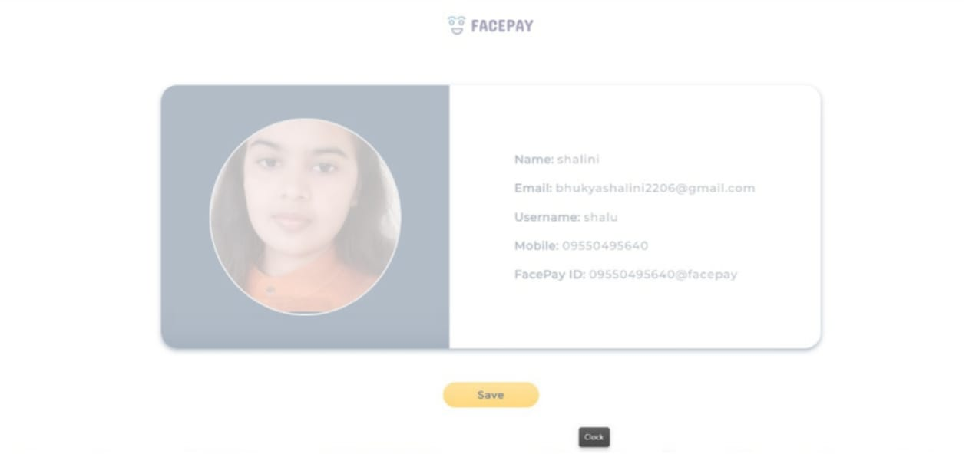
METHODOLOGY:
LINK OF IMPLEMENTATION:
https://github.com/Shrutimishra2002/FACE-RECOGNITION-FOR-TRANSACTIONS
Sign up
Image upload
Login (email , face Id, phone no)​
Payment successful
Face detection
Payment amount

Slide 6

SOCIETAL IMPACT/ NOVELTY::
Improved security
Increased convenience
Personalization
Ethical concerns
Legal and regulatory issues

Slide 7


